Slide 1
Geological Time

Slide 2
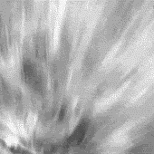
By the end of this lesson, you should be able to:
• | Explain what the geological timescale is, and what it is used for.
• | Explain what fossils are, and how are they relevant to the timescale.

Slide 3
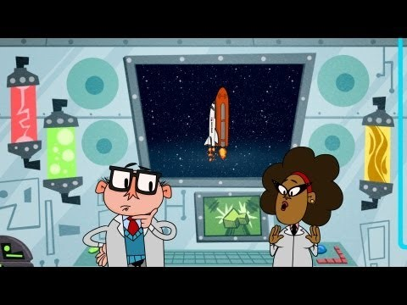

Slide 4
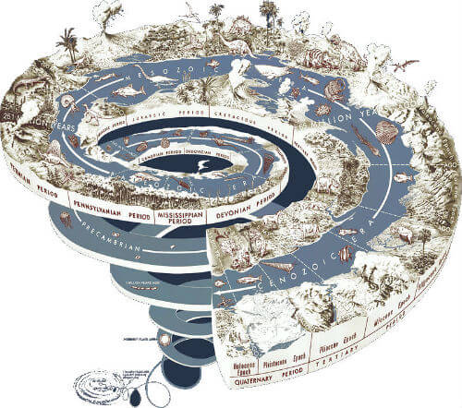
The history of the Earth spans so much time that geologists have divided it up using the geological timescale.
The geological timescale uses the time ranges of important fossils. Different organisms were alive in different time periods, so the fossils they left behind can be used to mark out the periods.

Slide 5
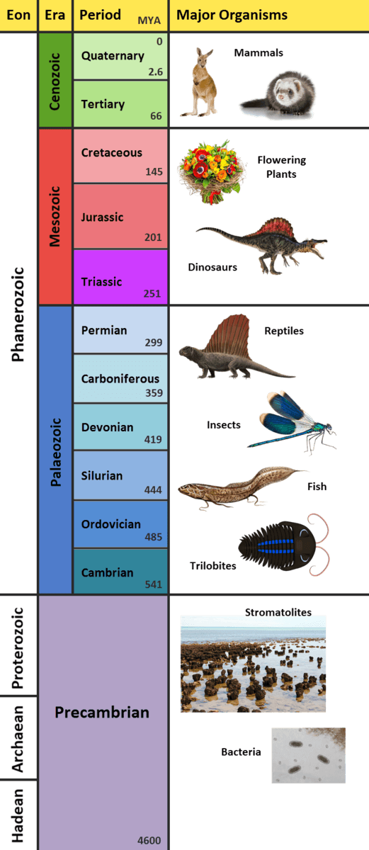
The creation of the geological timescale is one of the most impressive achievements in geology.

Slide 6


